Slide 1
Audio amplifier
Team 16 1-kyrolis atef 2-Habiba ahmed
3-shrouk sayed
4-shrouk mohamed
5-aya mohamed sayed

Slide 2
Audio amplifier
Purpose of this project:
**our purpose is to turn small signal to large signal using lm386. Components of project : 1- IC Lm386. 2- 4 capacitors (100uf, 220uf, 47nf and 10uf). 3- Adaptor to gain dc signal.
4- Potentiometer (10 k ohm).
5- Speaker.

Slide 3
Audio amplifier
--Amplifier Operation → the biasing of transistor is purely dc operation operation. The purpose of biasing is to establish a Q-point about which variations in current and voltage can accure in response to an AC input signal. In applications where a small signal voltage must be amplified Such as from an antenna or a microphone variations about Q-point are relatively small. Audio amplifier is designed to handle these small AC signal are often referred to AC small signal amplifier

Slide 4
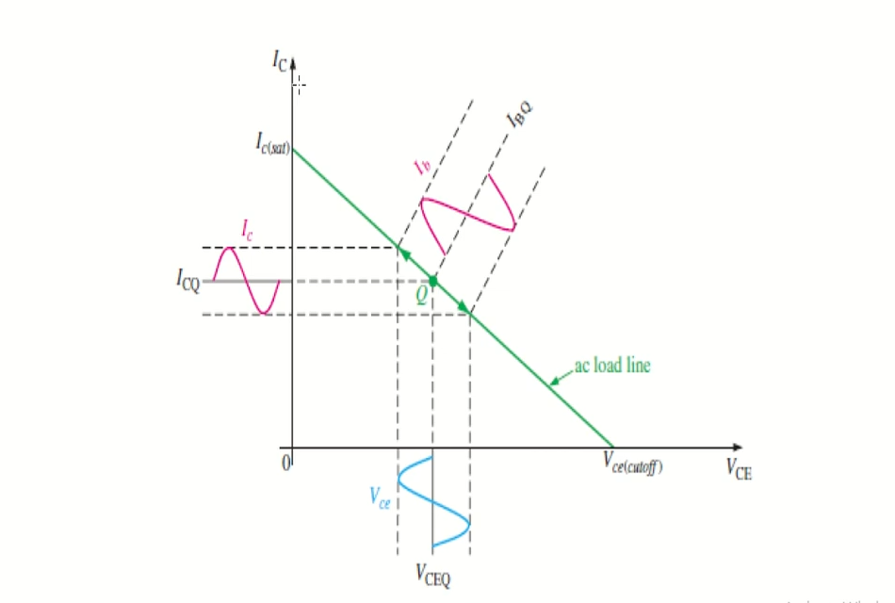
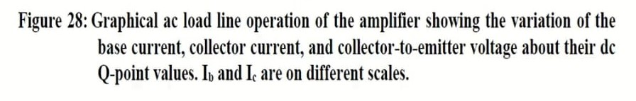

Slide 5
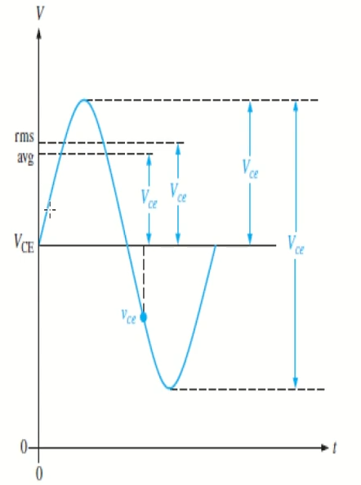
Audio amplifier
Q-point in Active region .
→IC,IE and IB are Dc quantity → Ic,Ib,Ie and Vce are RMS values (AC quantities).

Slide 6
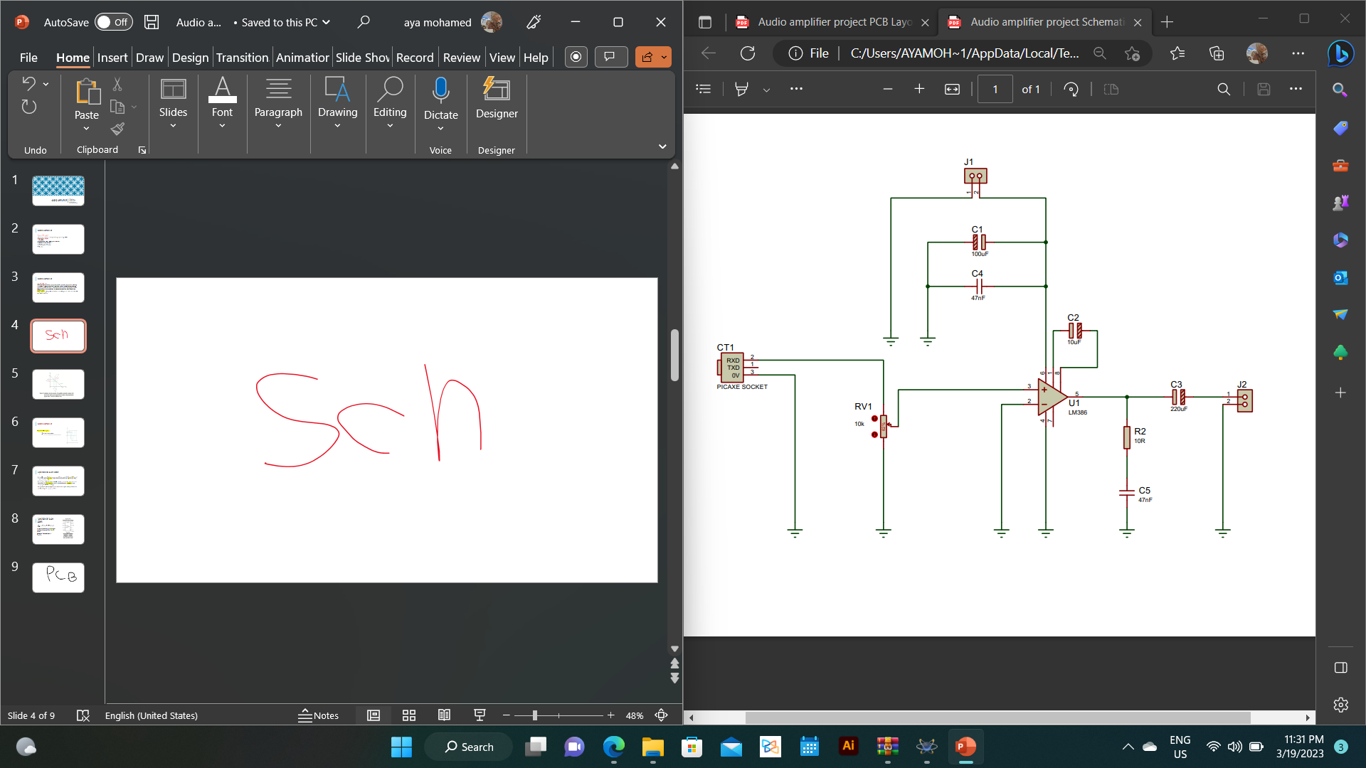

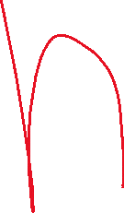


Slide 7
Function of each comp.
An Ic with a sunsoidal ac source capacitively coupled to a load (speaker ) capacitively coupled to pin 5 through c2 (220uf) as shown in schematic .
The coupling capacitor blocked DC and thus prevent the internal source resistance( the input DC) and the load Resistance (speaker) from changing the DC bias voltage.
the capacitors ideally appears as short to the signal voltage couses the pin (3) voltage to vary sunsoidal.

Slide 8
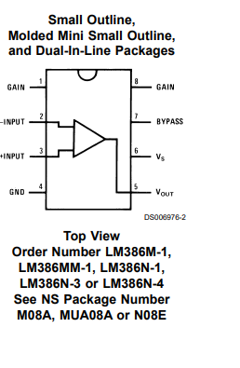
Function of each comp.
Above and below its DC bias level VBQ.
the resulting variation in pin (3) current produces a large variation in pin (5) current.
Because of the current gain of transistor.

Slide 9



All function in one !
name of comp. | Graphic | function | Its value
ic |  |  | lm386
pot |  |  | 10k ohm
capacitors |  |  | 100u,47nf,10uf,220uf
speaker |  |  | 3 watt ,4 ohm

